Slide 1
Disaster Tweets
Anderson, Taylor
Lawrence, Jonathan

Slide 2

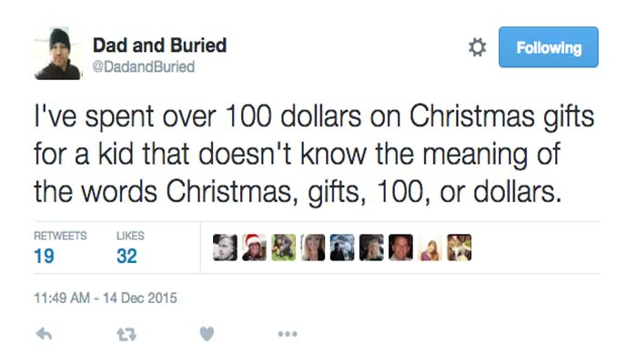
Project Goal
Background
Twitter is a place people go to talk about things that are going on in their life. If an emergency or disaster happens, Twitter will often be the first place that they go to comment on it.
Analysis
There are many reasons that it would be useful to be able to quickly identify and filter out tweets that relate to a disaster. We will be using Natural Language Processing techniques to try and identify tweets that are related to a disaster.

Slide 3

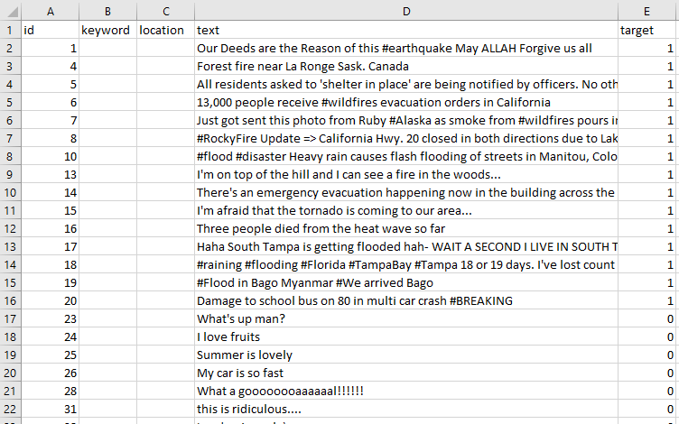
EDA
Data consisted of 20,000 tweets
Some of the data was pre-labeled as either “Disaster” or “Not a disaster”
The rest of the data was not labeled.

Slide 4
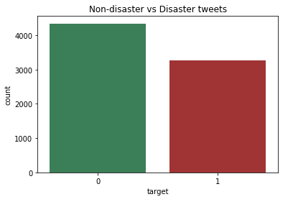
EDA
Features:
ID
Text
Location
Keyword
Target

Slide 5
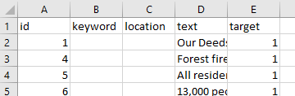
Data Cleaning: Removing unnecessary data
Replace ‘NA’ values with blanks
Remove unnecessary data to increase processing speed
Missing Values in Training Data | Missing Values in Test Data
61 | 26

Slide 6
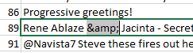
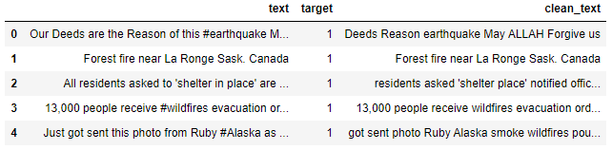
Data Cleaning: Removing HTML & Stopwords
Remove HTML characters
Remove stopwords (words that do not contribute to our analysis)

Slide 7
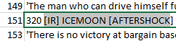

Data Cleaning: Removing special characters & URLs
Remove special characters
Remove URLs

Slide 8
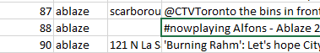
Data Cleaning: Removing hashtags
Remove hashtags which could change the meaning of a word

Slide 9
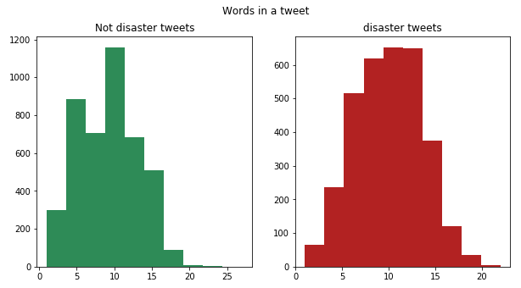
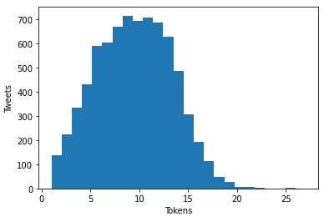
EDA: Visualizations

Slide 10
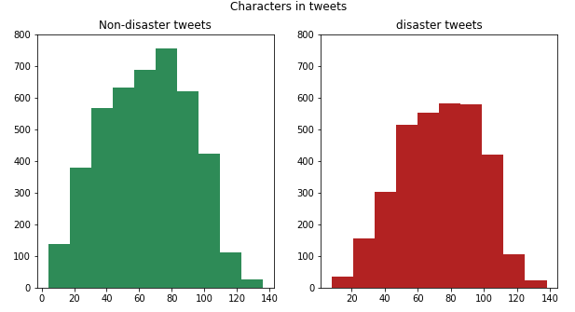
EDA: Visualizations

Slide 11
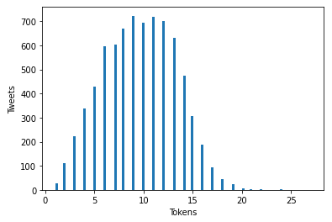
Modeling
Linear connection between the words and the result (disaster vs not-a-disaster)
Too many tokens and not enough data points, so we need to “shrink” the coefficients
Ridge Regression
Test 1 | Test 2 | Test 3 | Test 4 | Test 5
0.59449541 | 0.44851658 | 0.54648343 | 0.47977422 | 0.66666667

Slide 12
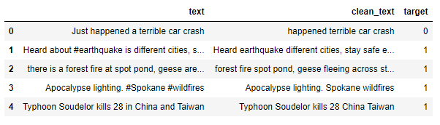
Classification
Proper classification
Added result to the original data
Wanted a simple way to visualize the data

Slide 13

Results
Challenges
Context
Sarcasm
Limited size
F1 score 0.67

Slide 14
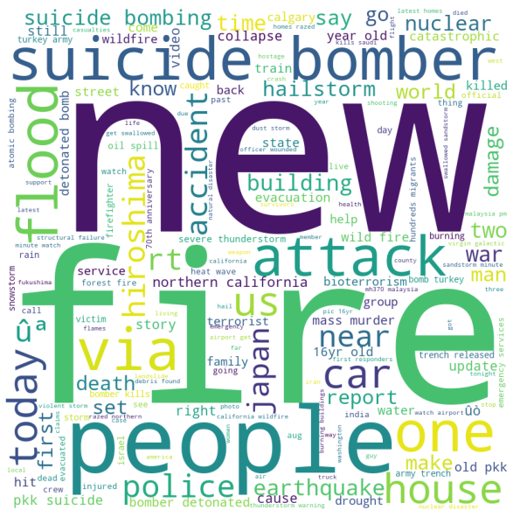
THANKS FOR YOUR TIME!

